Slide 1
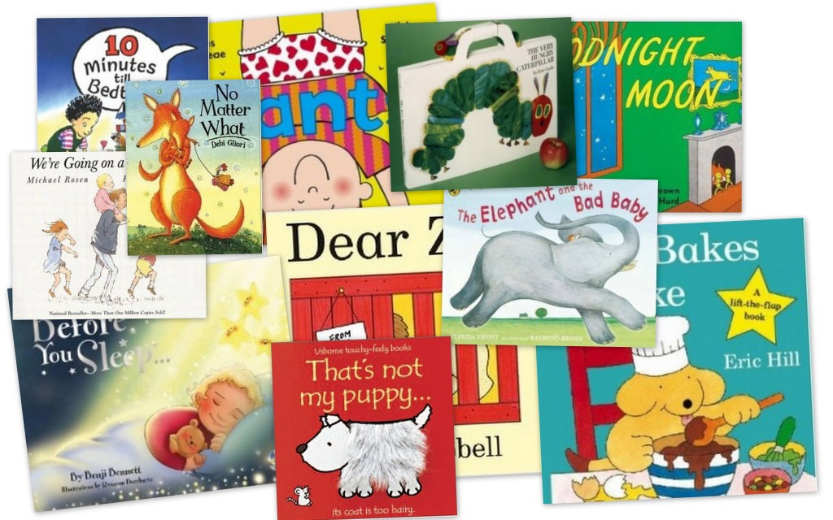
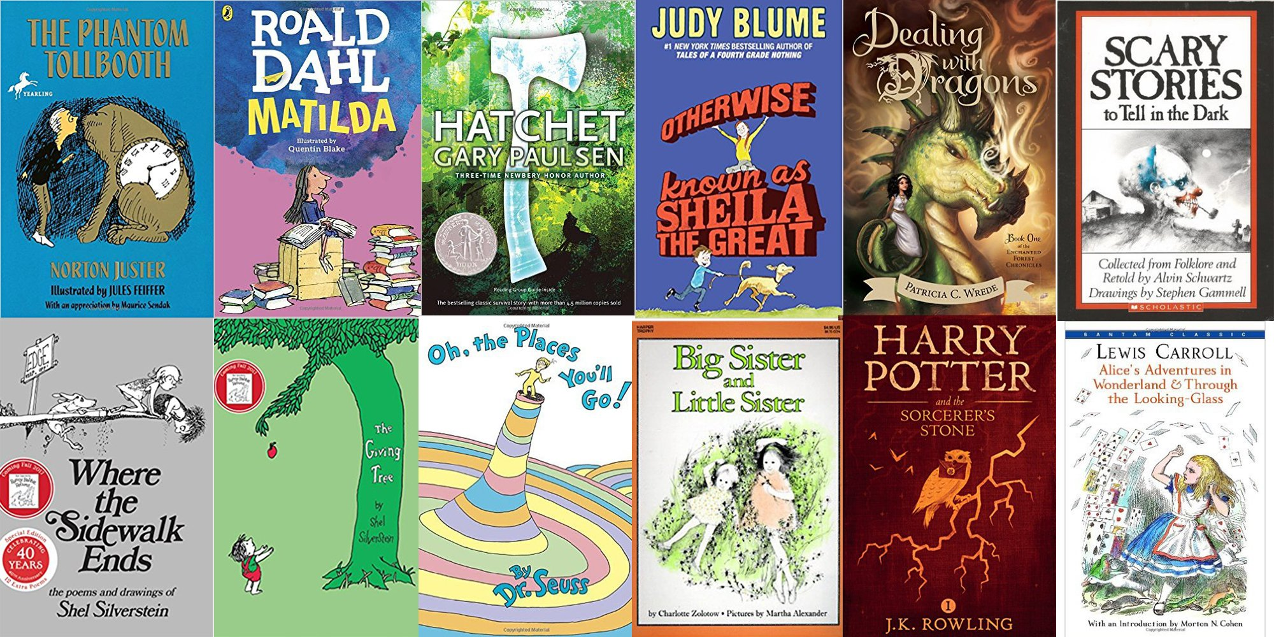
Reading Workshop

Slide 2
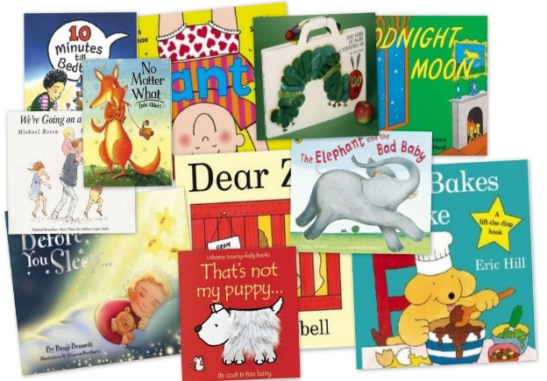
The Power of Reading!
Creating a love of reading in children is potentially one of the most powerful ways of impacting on academic standards in school.
There can be few better ways to improve pupils’ chances in school, or beyond in the wider world, than to enable them to become truly independent readers.
Reading is all about acquiring meaning; for
enjoyment, information and understanding.

Slide 3
Reading in School The Teaching of Reading
The National Curriculum
“A high-quality education in English will teach pupils to speak and write fluently so that they can communicate their ideas and emotions to others and through their reading and listening, others can communicate with them.
Through reading in particular, pupils have a chance to develop culturally, emotionally, intellectually, socially and spiritually. Literature, especially, plays a key role in such development. Reading also enables pupils both to acquire knowledge and to build on what they already know.”

Slide 4
Reading in School The Teaching of Reading
Phonics
Shared reading
Whole class guided reading
Independent reading
Focused reading activities
Reading across the curriculum
Class novels and stories
The hearing of reading is NOT the teaching of reading

Slide 5
What is phonics?
Phonics is a way of teaching children how to read and write. It is a method of teaching people to read quickly and skillfully by correlating sounds with symbols in an alphabetic writing system.
For example, when you learn that a B makes the sound/b/ and that ‘tion’ can make sounds like /shun/, you are learning phonics.
Understanding phonics will also help children know which letters to use when they are writing words.

Slide 6
In school we follow the Monster Phonics scheme. This is a DfE validated phonics scheme. Monster Phonics is easier to learn and remember. Monster Phonics helps children to learn and recall spellings by using colour. Each sound and colour is also represented by a monster that makes that sound (a sound cue). This brings phonics to life and makes Monster Phonics highly engaging. It is delivered to all children in Reception and Year 1/2 daily.
The Teaching of phonics

Slide 7
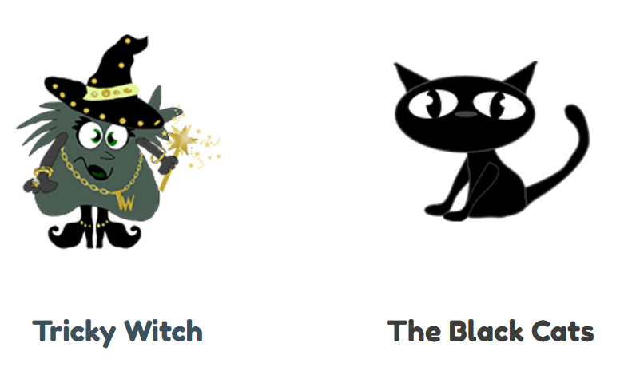

Slide 8
I was never taught phonics and I can read!

Slide 9
Examples of activities you can do at home…
www.phonicsplay.co.uk
www.phonicsbloom.com
www.ictgames.com
www.teachyourmonster.org
Hiding words on post it notes
Bingo
Say and swap
Chalking on the pavement, writing with paint
Listening and attention
Magnetic letters in the bath or on a tray
Nonsense words and sentences
Pass the hat
Dots and dashes

Slide 10
Phonics screening check – Year 1 children
The phonics screening check is designed to confirm whether individual children have learnt phonic decoding and blending skills to an appropriate standard.
The test contains 40 words. Each child will sit one-to- one and read each word aloud to a teacher. The test will take approximately 10 minutes per child. The list of words the children read is a combination of 20 real words and 20 pseudo words (nonsense/alien words).

Slide 11
Examples of words on the Phonics Screening

Slide 12
Understanding (Comprehension)
Being able to read does not mean you understand what you read.
Your child might sound like a good reader but may not necessarily understand what the text means.
The best way to develop understanding is to talk about texts.

Slide 13
Reading requires two skills
Understanding
The ability to understand the meaning of the words and sentences in a text.
The ability to understand the ideas, information and themes in a text.
If a child understands what they hear, they will understand the same information when they read.
Phonics and Word Recognition
The ability to recognise words presented in and out of context.
The ability to blend letter sounds (phonemes) together to read words.

Slide 14
Throughout the whole school, guided reading sessions are used to teach reading skills.

Slide 15
KS1 – Year 1 and 2
Vocabulary | Draw on knowledge of vocabulary to understand texts
Infer | Make inferences from the text
Predict | Predict what might happen on the basis of what has been read so far
Explain | Identify / explain key aspects of fiction and non-fiction texts, such as characters, events, titles and information
Retrieve | Identify / explain key aspects of fiction and non-fiction texts, such as characters, events, titles and information
Sequence | Identify and explain the sequence of events in texts

Slide 16
How many varieties of Heinz beans are there?
retrieval
What, on the advert, might persuade parents to feed this to their children?
inference
Explain what Heinz have done to make the beans appear to be ‘truly magic’ in this advert.
explain the author’s choices

Slide 17
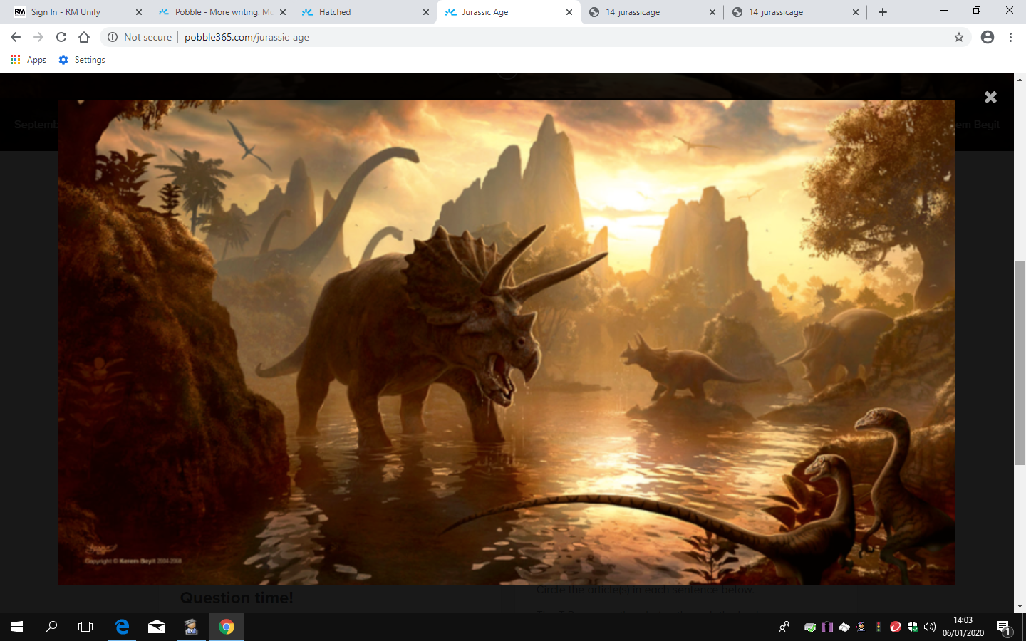
Vocabulary
What adjective has been used to describe the shoe-maker?
Match the word to the meaning
scolded |  | shaking in terror
trembling |  | walking confidently
exclaimed |  | something said in surprise
strode |  | being told off
nonsense |  | laughed at
scoffed |  | does not make sense
Circle the words that describe the dinosaur.
What does the word rich mean?

Slide 18
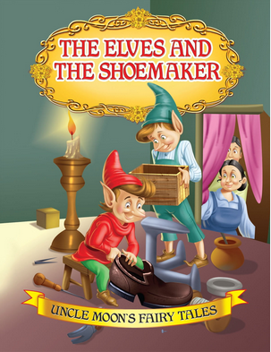
Infer
How do you think the shoemaker felt when he woke up to find new shoes?
Thinking about what we know about Elmer’s character, how do you think he will respond to the snow in this story? What sort of things do you think he will get up to?
What do you think happened to the Mars cat after the story?
Why might the fire have started in a bakery?

Slide 19
Predict
Predict what the story is going to be about.
What do you think will happen next?
Listen to the blurb. What do you think the story is about?

Slide 20
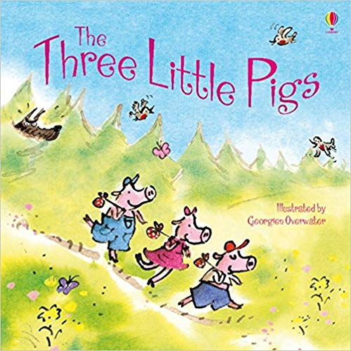
Explain
This week we have enjoyed reading ‘The Three Little Pigs’ in class.
What did you like most about the book?
Would you like to live in this setting?
Was there anything that you didn’t like about the book?
Who was your favourite character? Why?

Slide 21
Retrieve
Why did Mummy pig tell the children they needed to build houses of their own?
They were too noisy
They were too big
They made too much mess
Who were the pigs afraid of?
What information would we find on page 46?
How did the rainbow become colourful again?

Slide 22
Sequence
Can you sequence the pictures?
What happens next?
What happened first?
What happened at the beginning, middle and end of the story?

Slide 23
Reading at Home

Slide 24
Reading at Home – Enjoy!
Make reading visible - have books available in your home
Share books every day
Talk about books.
Sit and listen - don’t do chores around the reader!
Respect choices.

Slide 25
What to do if your child is stuck
Use phonics first. What sound does the word begin with? Can you say the sounds in the word? Blend them together.
Read to the end of the sentence. What would make sense?
What is the text about – what might fit here?
Does it sound right?
Look at the picture. Does it help?

Slide 26
Talking about books
Do you like this book; why?
Who is your favourite character?
Tell me about a character in the book.
Which words tell you what the character is like?
How would you feel?
What do you think will happen next?
What would you do?
What have you learned about …… in your book?
What can you tell me about…?

Slide 27
Hearing your child read
Choose a quiet time and give your child your full attention.
Give support if required using the strategies explained earlier.
Explain the meaning of new words.
Talk about the text using open questions.

Slide 28
Have fun!!

