Slide 1
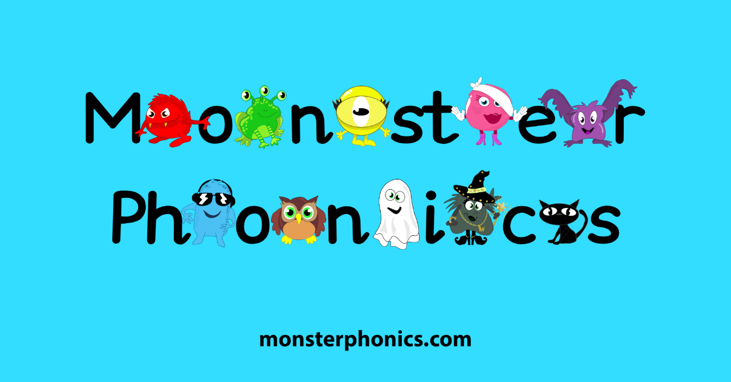
Phonics at Co-operative Education East

Slide 2
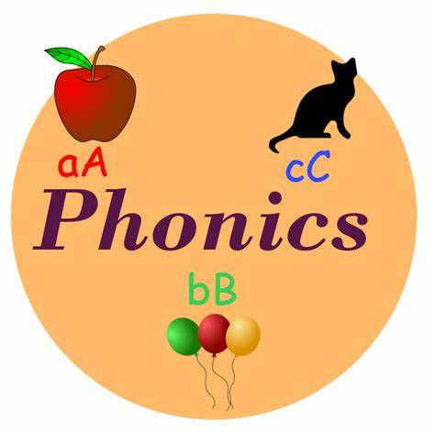
What is phonics?
A method of teaching people to read quickly and skillfully by correlating sounds with symbols in an alphabetic writing system.
When you learn B makes the sound/b/ and that ‘tion’ can make sounds like /shun/, you are learning phonics.

Slide 3
In phonics children are taught how to:
Recognise the sounds that each individual letter makes;
Identify the sounds that different combinations of letters make such as /sh/ or /ee/;
Blend these sounds together from left to right to make a word.
Children can then use this knowledge to ‘decode’ new words that they hear or see. This is the first important step in learning to read.

Slide 4
Pure Speech Sounds - Bing video
It is important we use the pure sound as s/a/t is easier to blend than suh/ah/tuh.
Listen to the sound your child is making and look out for any extra sounds.

Slide 5
I was never taught phonics and I can read!

Slide 6
Why Phonics? Research shows that when phonics is taught in a structured way – starting with the easiest sounds and progressing through to the most complex – it is the most effective way of teaching young children to read. It is particularly helpful for children aged 5 to 7. Almost all children who receive good teaching of phonics will learn the skills they need to tackle new words. They can then go on to read any kind of text fluently and confidently, and to read for enjoyment. Children who have been taught phonics also tend to read more accurately than those taught using other methods, such as ‘look and say’. This includes children who find learning to read difficult, for example those who have dyslexia. (The information above is directly from the Department of Education’s ‘Learning to read through phonics: information for parents’ document.)

Slide 8
Phonics Terminology
Phoneme
A phoneme is an oral/speech sound and is the smallest unit of sound in a word. ch/a/t or sh/ee/p
Grapheme
A grapheme is the letter or letters that represent the phonemes sound – how we spell the word.
Digraph
Two letters which make one sound. Consonant diagraph -sh/th/ch. Vowel diagraph – ai, ee, ie
Trigraph
Three letters which make one sound. igh (light), ear (hear), air (hair)
Quadgraph
Four letters which make one sound. eigh (eight), ough (cough)
Adjacent Consonants or Blends
A group of consonants that have no vowel between then and blend together. sl, br, spr, fl, tr, spl
Morpheme
A meaningful morphological unit of a language that cannot be further divided. Sing – singing. Come – incoming

Slide 9
Prefixes
Prefixes are letters which we add to the beginning of a word to make a new word with a different meaning. Prefixes can, for example, create a new word opposite in meaning to the word the prefix is attached to. They can also make a word negative or express relations of time, place or manner. Possible – inpossible. Cook – overcook.
Suffixes
A suffix is a letter or group of letters that goes on the end of a word and changes the word's meaning. Sometimes they also change the original word's spelling. When adding a suffix you might have to double the last letter. For example when adding 'ed' to 'drop' you also double the p so it becomes 'dropped'. Some suffixes have specific uses. Adding ‘ing’ can change a noun into a verb eg 'garden' to 'gardening'. While ‘ed’ can put a verb in the past tense eg 'jump' to 'jumped'.

Slide 10
Vowels
A vowel is a sound made from your lungs that your lips and tongue do not aid with the pronunciation. a, e, i, o, u
Consonants
A consonant is a speech sound that is articulated with complete or partial closure of the vocal tract. Examples are [p] and [b], pronounced with the lips; [t] and [d], pronounced with the front of the tongue; [k] and [g], pronounced with the back of the tongue; [h], pronounced in the throat; [f], [v], and [s], pronounced by forcing air through a narrow channel; and [m] and [n], which have air flowing through the nose.
Syllable
A unit of pronunciation having one vowel sound, with or without surrounding consonants, forming the whole or a part of a word. Al/pha/bet
CVC, CCVC, CVCC
Abriviations for the order of vowels and consonants in a word.
c/a/t – c/v/c, f/l/a/g - c/c/v/c, w/e/n/t – c/v/c/c
Split Diagraph
Where a vowel is separated from the letter ‘e’ by a consonant.
a_e, e_e, i_e, o_e, u_e (cake, eve, hive, nose, cube)

Slide 11
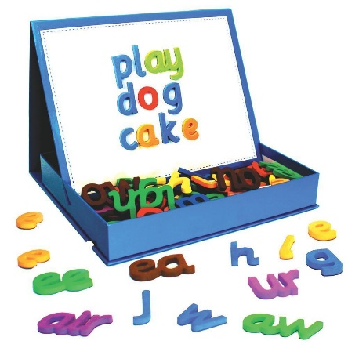
How can I help at home?
Listen to your child read their reading book from school regularly.
Use magnetic letters to help word build.
Give children news papers and let them highlight the words they can read.
Use websites such as Monster Phonics, Phonics Play, Letters and Sounds, ICT games, Teach Your Monster to Read (some accessible from the schools website)
Encourage children to mark make independently (shopping lists, birthday wish lists, thank you cards, drawing their Lego creations etc)
Visit the schools website for more information.
Talk to the class teacher.

Slide 12
Read, Read, Read!
Phonics helps us teach children how to read but it is vital we continue to foster a love of reading.
No matter the age of child – every day find time to read to them.
Snuggle up together and share a book they want to read.
Use your local library. Recommend books to friends. Celebrate books!

Slide 13
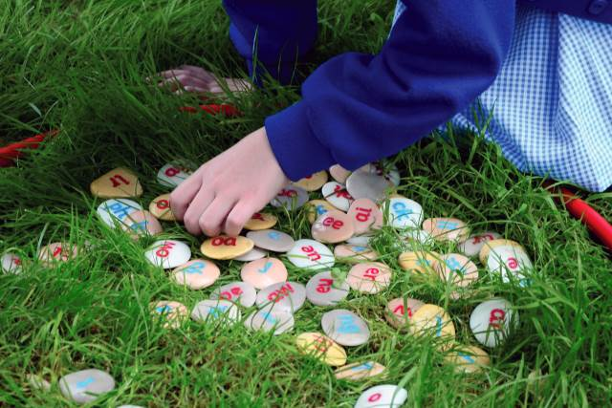
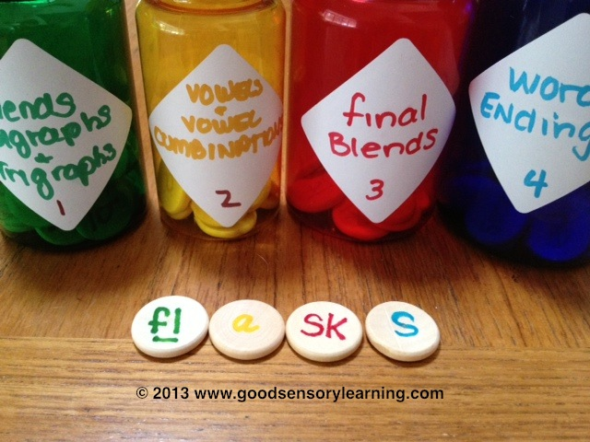
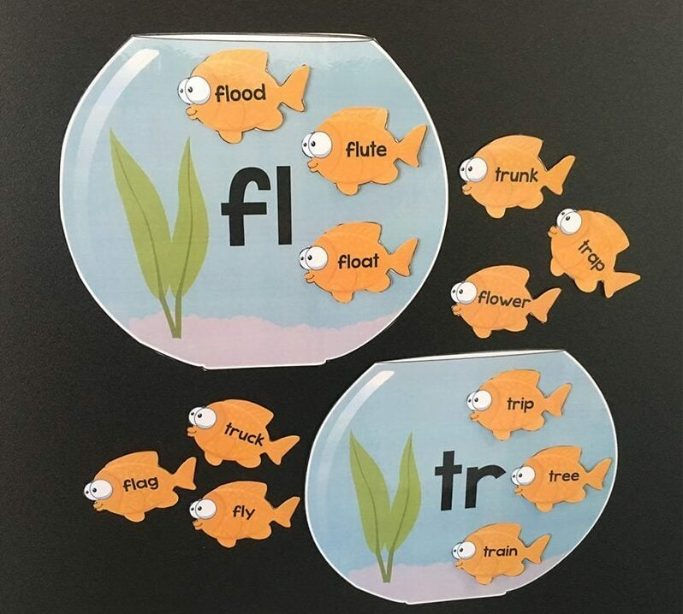
Any questions?
We are now going to join our children in their class. Have fun!

